Slide 1
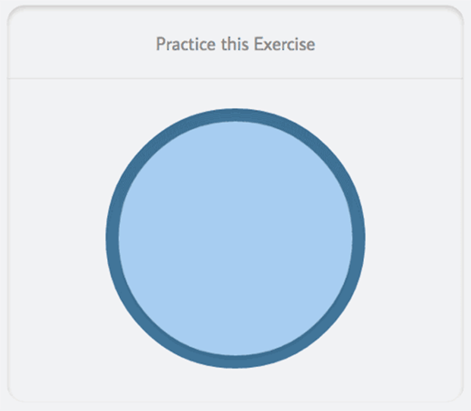

Slide 2
Circle of Support
School Counselor
Mom
Dad
ME
Brother
Best Friend
Theater Club
English Teacher
Church
Notes:
The purpose of this resource is to facilitate a conversation about various sources of social support the teen has access to. You can help your student identify trusted adults and friends by asking questions like the following:
Who are some people in your life that will be there for you if you need help with something?
Who are some people in your life that you can talk to when you feel sad or upset?
Who are some people in your life that can almost always help you feel better if you are down?
Who are some people in your life you can trust to protect you?
Emphasize to the child that it is possible to have different levels of closeness / trust with different people. Utilize the inner circle for highly trusted adults or peers (e.g., family, best friends) and the outer circle for more distal supports (e.g., teachers).
Use the “text box” function to add the people your students lists to their corresponding circles.
You can also what places, organizations or other things that are important to them. For example church.
Being connected and having support is a huge protective factor.

Slide 3
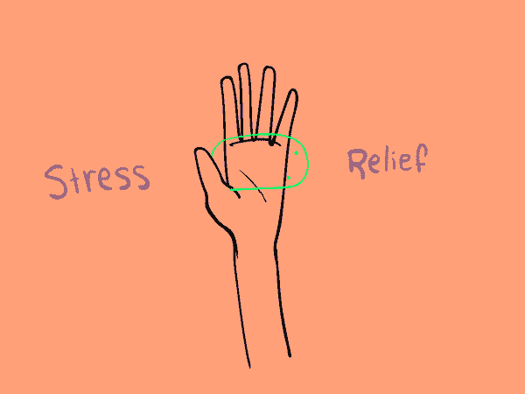
TRY THIS...

Slide 4
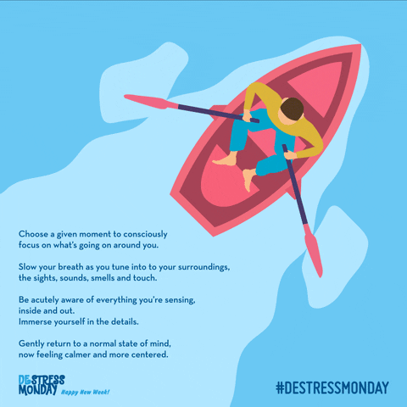
TRY THIS...

Slide 5
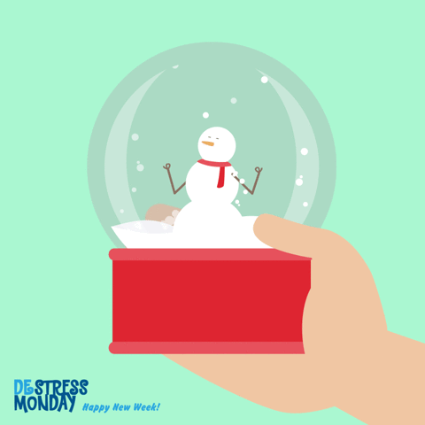
TRY THIS...
Notes:
Visualization
Emotional Blizzards - Calming the Storm
1. Imagine your thoughts and worries are like snowflakes in a shaken snow globe.
2. Breathe slowly. Visualize your negative feelings falling down.
3. Settle your mind as the snowflakes begin to rest on the ground.
4.Spend a mindful minute or two to imprint your positive, serene feelings.

